Slide 1

509 ARMY BASE WORKSHOP INDUSTRIAL TRAINING PROJECT
PROJECT NO. - 1
PROJECT NAME-
PASS MANAGEMENT SYSTEM

Slide 2
SYNDICATE - 1 (CS)
SYNDICATE MEMBERS :-
SHRUTI SINGH (CS-1)
BHOR KULSHRESHTHA (CS-3)
YAMINI CHAHAR (CS-2)
VISHWANATH PRATAP SINGH (CS-4)

Slide 3
INTRODUCTION
The "Pass Management System" has been developed to override the problems prevailing in the practicing manual system. This software is supported to eliminate and in some cases reduce the hardships faced by the manual system. Moreover this system is designed for the particular need of the 509 Army Base Workshop to carry out operations in a smooth and effective manner. The application is reduced as much as possible to avoid errors while entering the data. No formal knowledge is needed for the user to use this system. Thus by this all it proves it is user-friendly. Pass Management System , as described above, can lead to error free, secure, reliable and fast management system. Thus it will help organization in better utilization of resources.

Slide 4
ABSTRACT
The purpose of Pass Management System is to automate the existing NTR/DTR manual system by the help of computerized equipments and full fledged computer software, fulfilling their requirements, so that their valuable data/information can be stored for a longer period with easy accessing and manipulation of the same. The required software is developed to ease the process of taking NTR and DTR . This Software has three main users. They are:-
SUPERADMIN
ADMIN
EMPLOYEE

Slide 5
OBJECTIVE
The main objective of the Pass Management System is to manage all the records of NTR(Not To Return) and DTR(Due To Return) taken by the employess. The purpose of the project is to build an application program to reduce the manual work for managing the NTR AND DTR records. It tracks all the details about employees working in 509 Army Base Workshop, NTR and DTR records taken by them.

Slide 6
HARDWARE REQUIREMENTS
S.NO. | DESCRIPTION
1 | PC with 250 GB or more hard disk.
2 | PC with 2 GB RAM.
3 | PC with Pentium 1 and above.

Slide 7
SOFTWARE REQUIREMENTS
S.NO. | DESCRIPTION | TYPE
1 | Operating System | Windows XP/Windows
2 | Language | HTML,CSS and PHP
3 | Database | MySQL
4 | IDE | Visual Studio Code
5 | Browser | Google Chrome

Slide 8
NEED
The old manual system was suffering from a series of drawbacks. Since whole of the system was to be maintained with hands the process of keeping, maintaining and retrieving the information was very tedious and lengthy.
NTR and DTR were taken manually, by writing the reason on a piece of paper and get it signed by their respective OIC’s. The records were never used to be in a systematic order. There would always be unnecessary consumption of time while entering records and retrieving records. It was very difficult to track these records.

Slide 9
.
One more problem was that it was very difficult to find errors while entering the records. For these reasons we have provided many features in our system. It is partially automated (computerized), actually existing system is quite laborious as one has to enter same information different places. It reduces the human efforts of checking the papers for Pass taken by the employees manually and maintaining it in folders and files. With the implementation of computerized system, the task of keeping records in an organized manner will be solved. The greatest of all is the retrieval of information, which will be at the click of the mouse. So, the proposed system helps in saving the time in different operations and making information flow easy. giving valuable reports.

Slide 10
DATA FLOW DIAGRAM
ADMIN MANAGEMENT
DTR MANAGEMENT
PASS MANAGEMENT SYSTEM
EMPLOYEE MANAGEMENT
NTR MANAGEMENT
.

Slide 11
SUPERADMIN can
manage all the data of employees.
manage all the data of admins.
manage the records of NTR and DTR taken by employees.
add a new admin and a new employee.
delete the NTR and DTR data of particular employee.
take of backup the database.

Slide 12
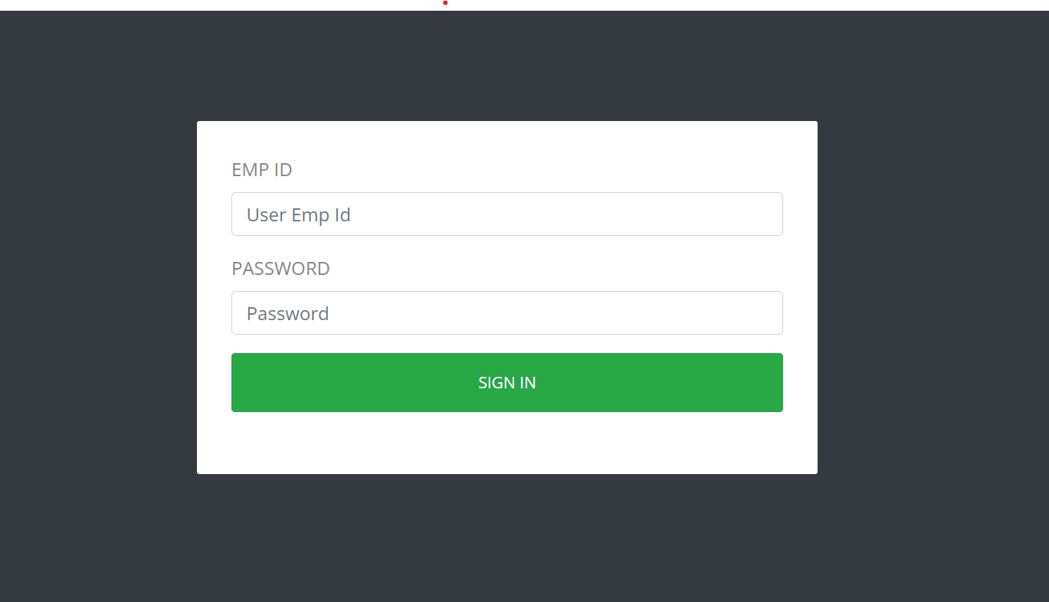
LOGIN PAGE
ENTER EMP ID OF THE USER
ENTER PASSWORD OF THE USER
PRESS THIS BUTTON TO SIGN IN

Slide 13
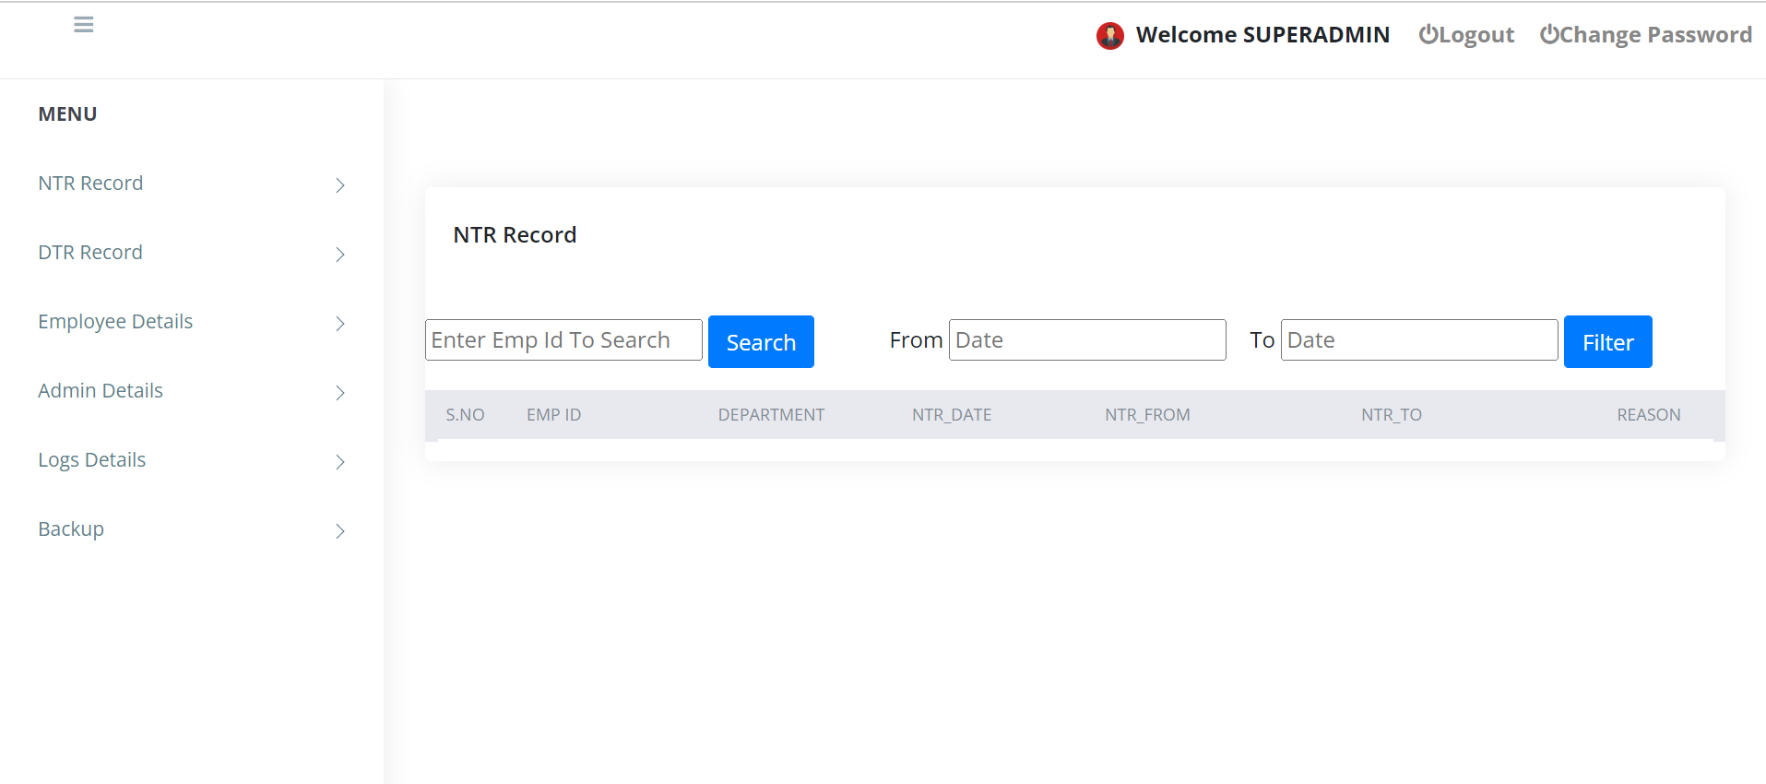
WHEN SUPERADMIN IS LOGGED IN
THIS IS THE MENU THAT SUPERADMIN CAN ACCESS

Slide 14
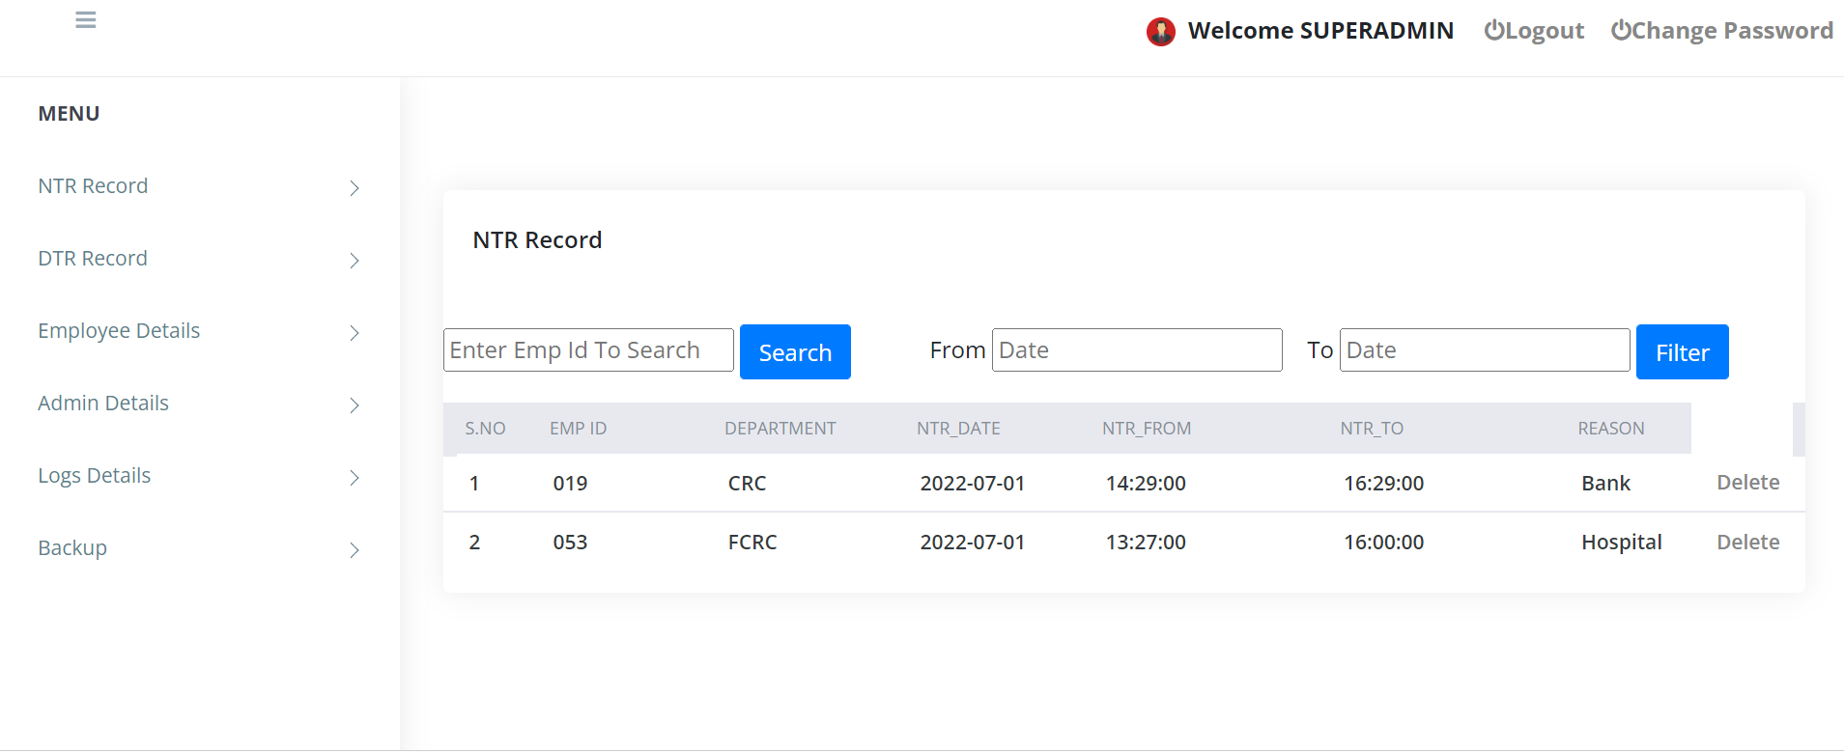
NTR RECORD
CLICKING ON THIS BUTTON SUPERADMIN WILL BE ABLE TO SEE ALL THE NTR RECORDS

Slide 15
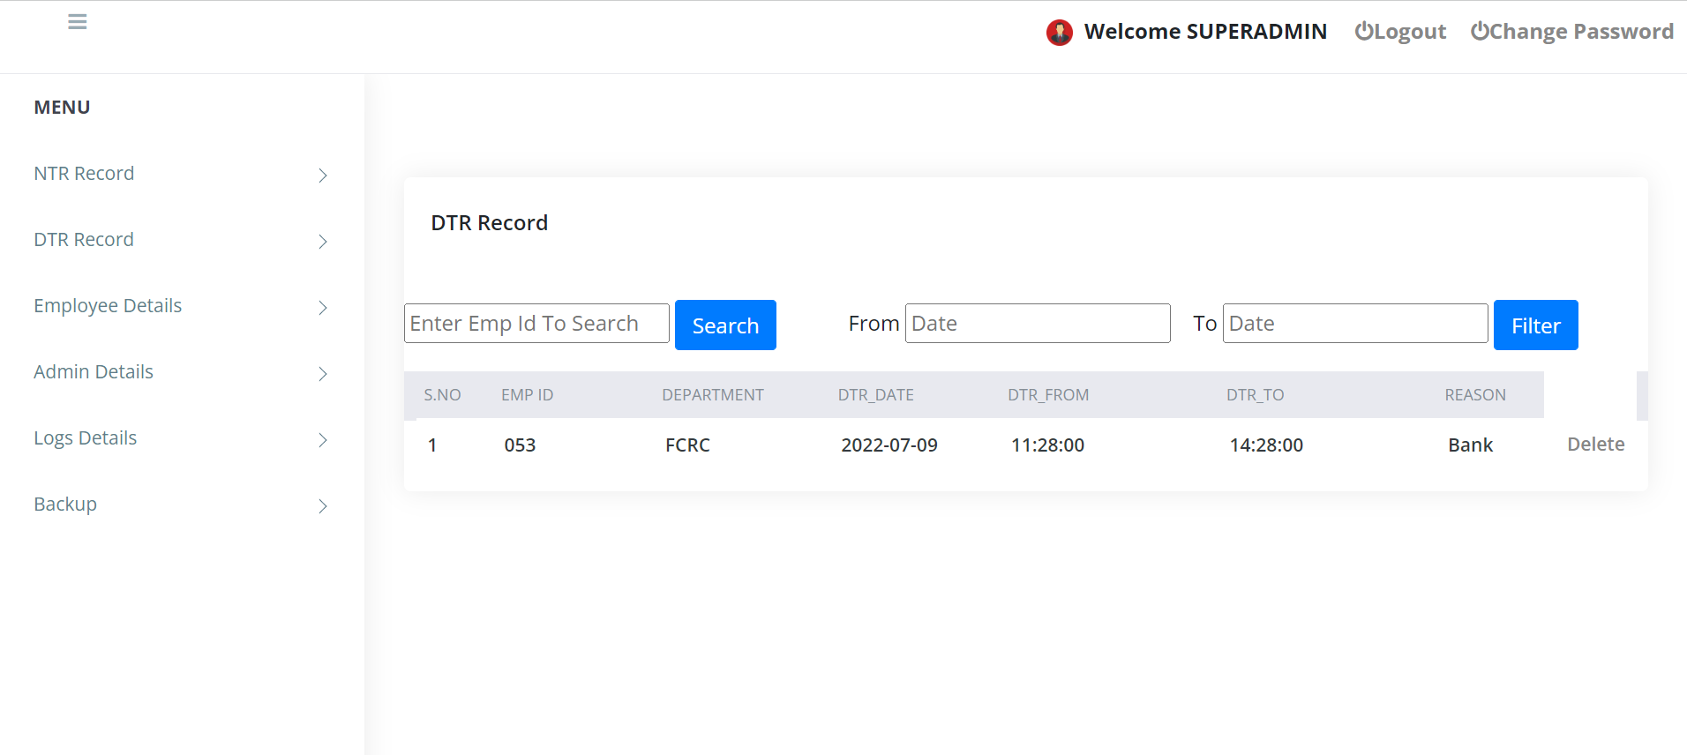
DTR RECORD
CLICKING ON THIS BUTTON SUPERADMIN WILL BE ABLE TO SEE ALL THE DTR RECORDS

Slide 16
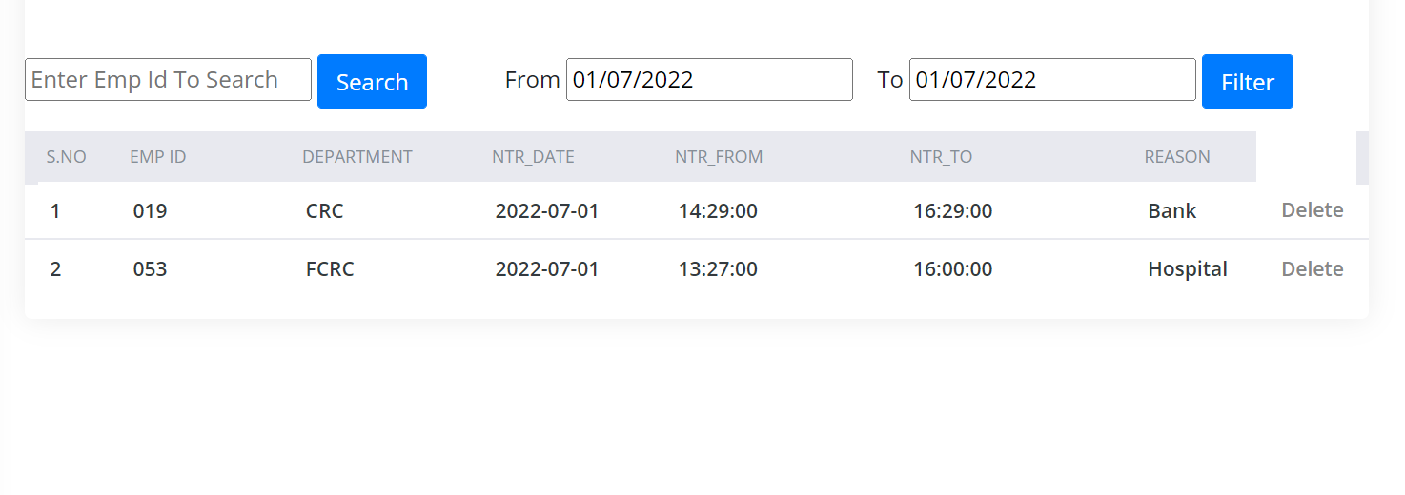
DELETING NTR AND DTR RECORD
BY CLICKING THIS BUTTON SUPERADMIN CAN DELETE THE NTR AND DTR RECORD OF PARTICULAR EMPLOYEE

Slide 17
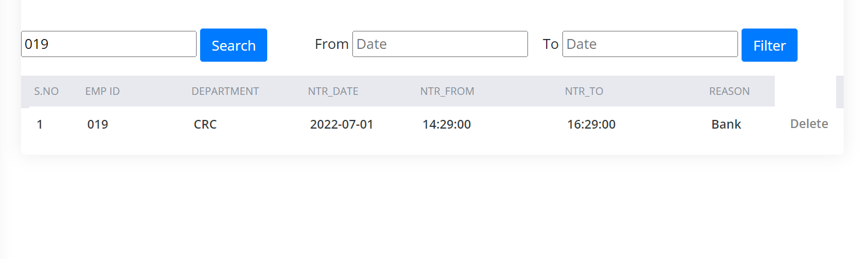
FILTERING OUT NTR AND DTR RECORD BY EMP ID
BY ENTERING EMP ID AND CLICKING ON SEARCH BUTTON SUPERADMIN CAN FILTER OUT THE NTR AND DTR DETAILS.

Slide 18
FILTERING OUT NTR AND DTR BY DATE
BY ENTERING FROM AND TO DATE AND CLICKING ON FILTER BUTTON SUPERADMIN CAN FILTER OUT THE NTR AND DTR DETAILS.

Slide 19
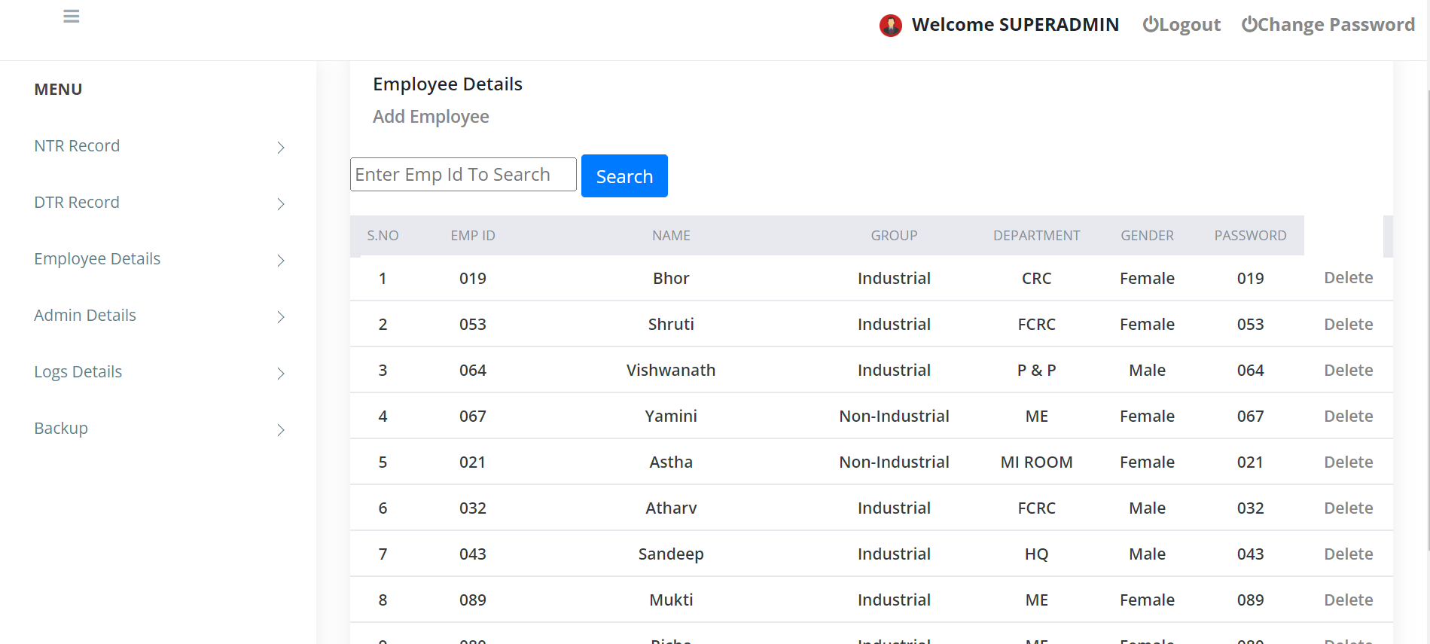
EMPLOYEE DETAILS
BY CLICKING ON THIS BUTTON SUPERADMIN CAN SEE ALL THE DATA OF EMPLOYEES
BY CLICKING THIS BUTTON SUPERADMIN CAN ADD NEW EMPLOYEES

Slide 20
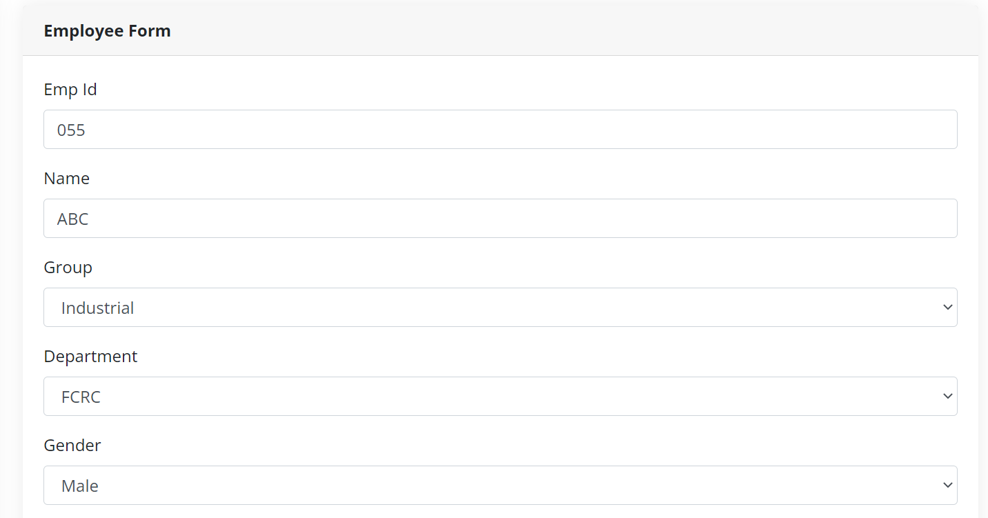
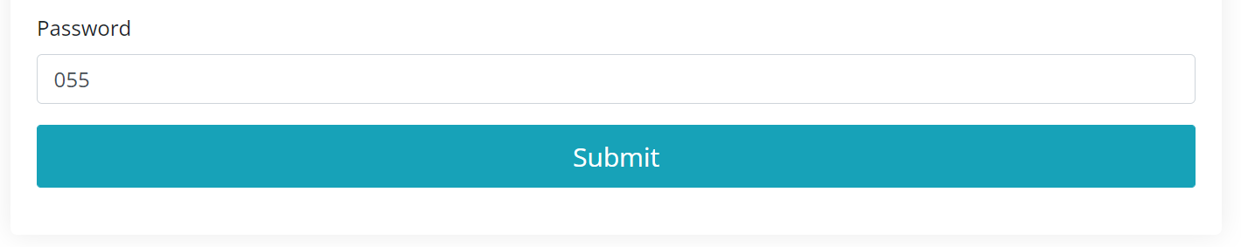
ADD EMPLOYEE

Slide 21
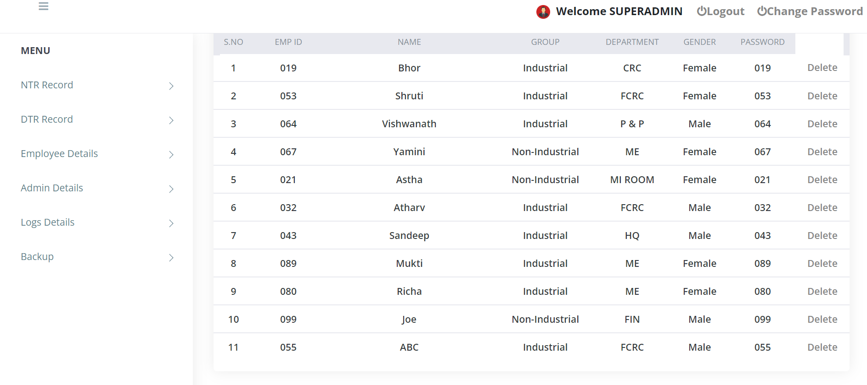
NEW EMPLOYEE ADDED
NEW EMPLOYEE IS ADDED AND DISPLAYED IN THE EMPLOYEE DETAILS PAGE.

Slide 22
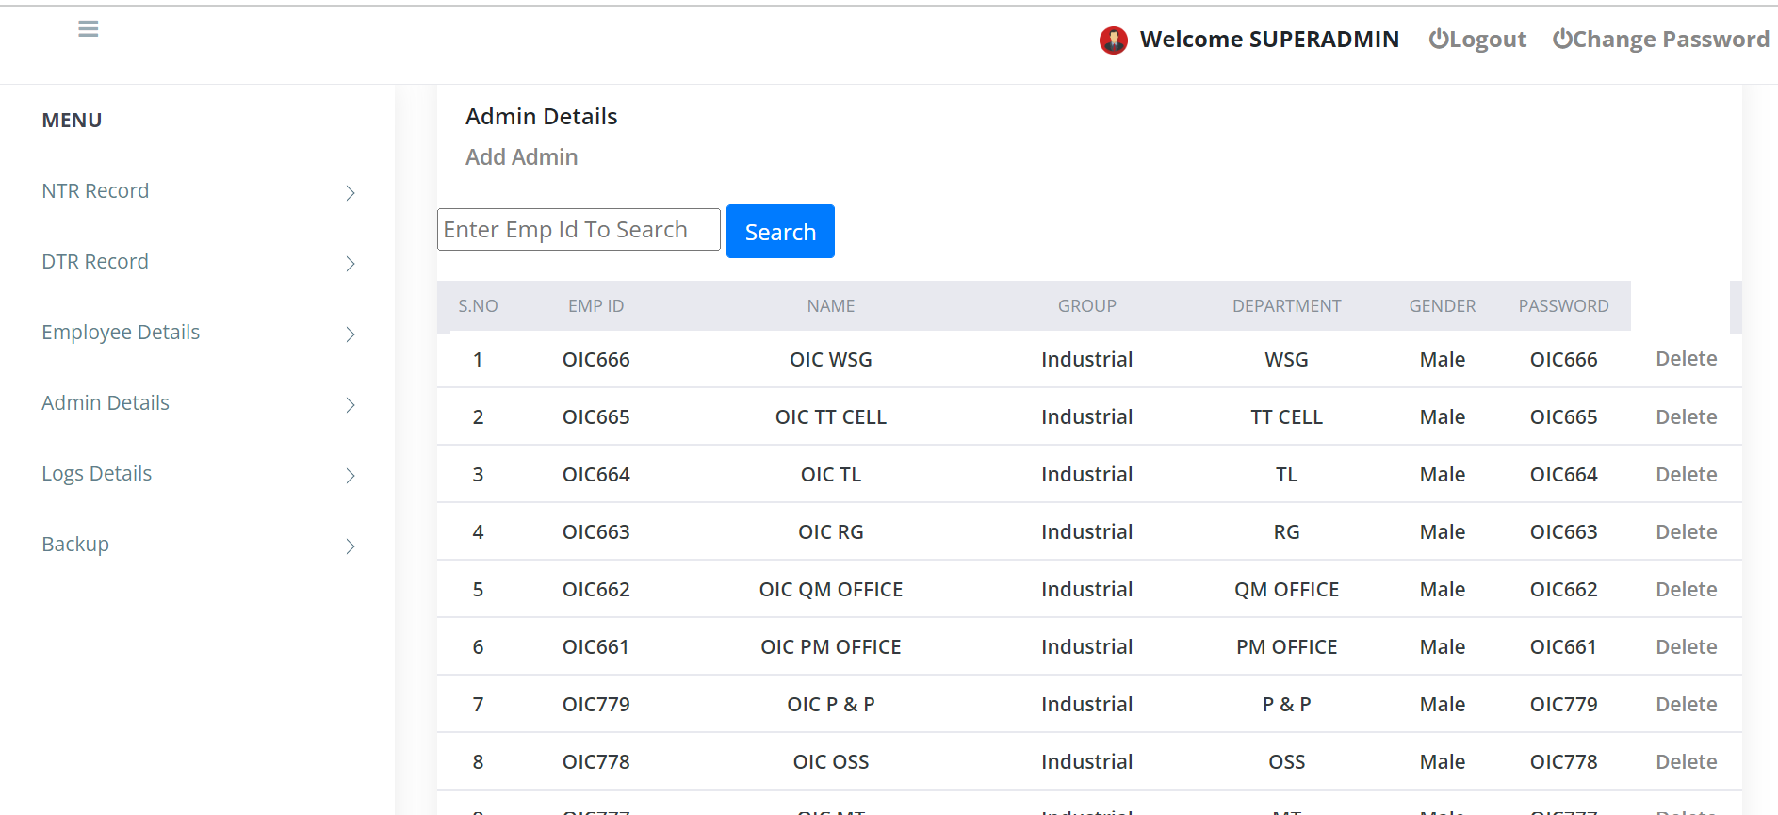
ADMIN DETAILS
BY CLICKING THIS BUTTON SUPERADMIN CAN ADD NEW ADMINS
BY CLICKING THIS BUTTON ADMIN DETAILS WILL BE SHOWN TO SUPERADMIN

Slide 23
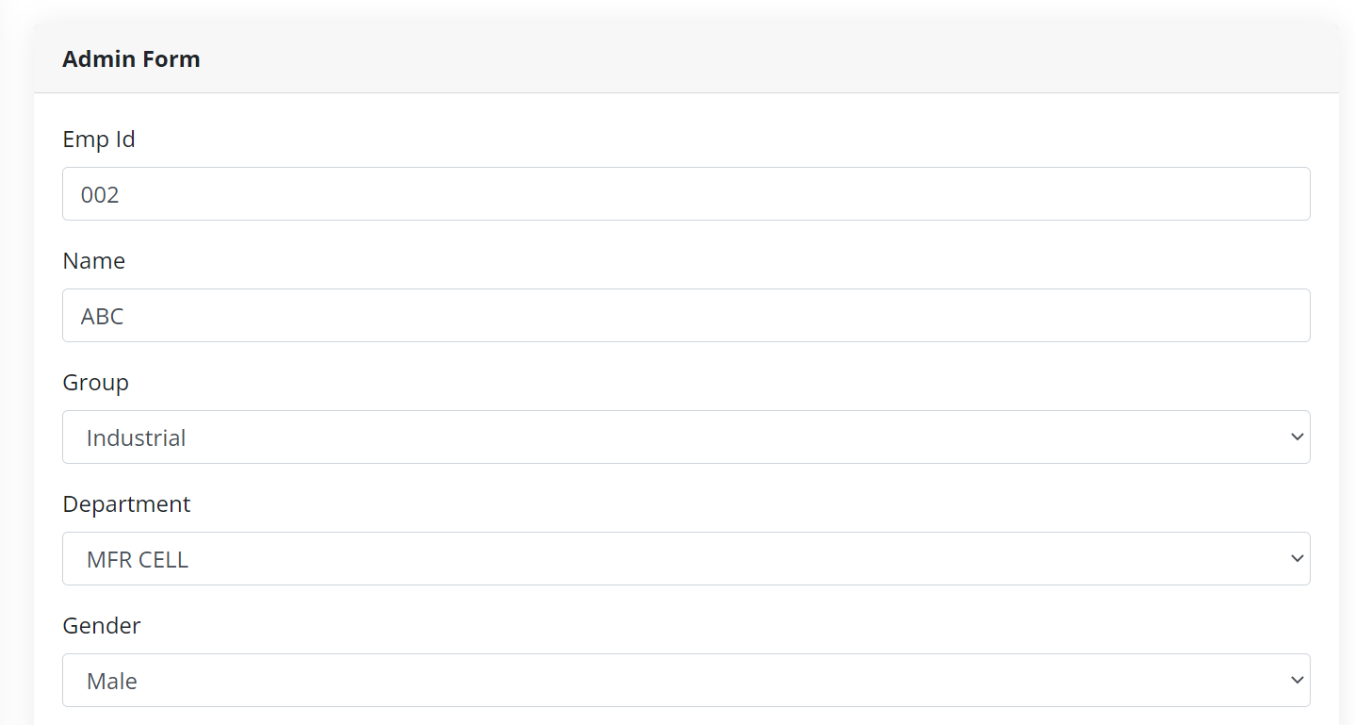
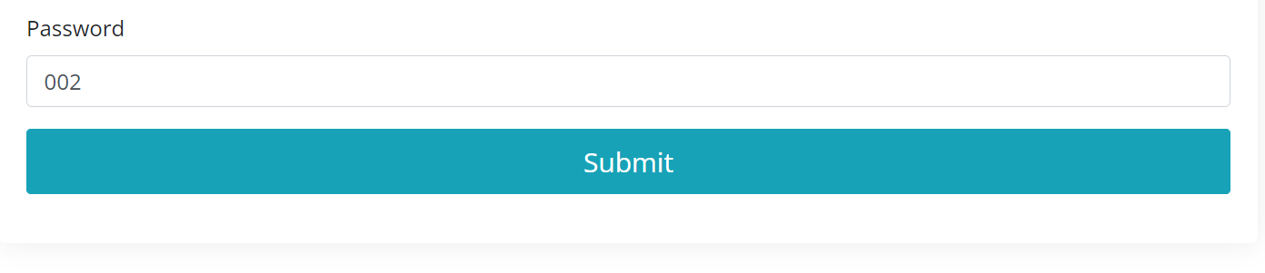
ADD ADMINS

Slide 24
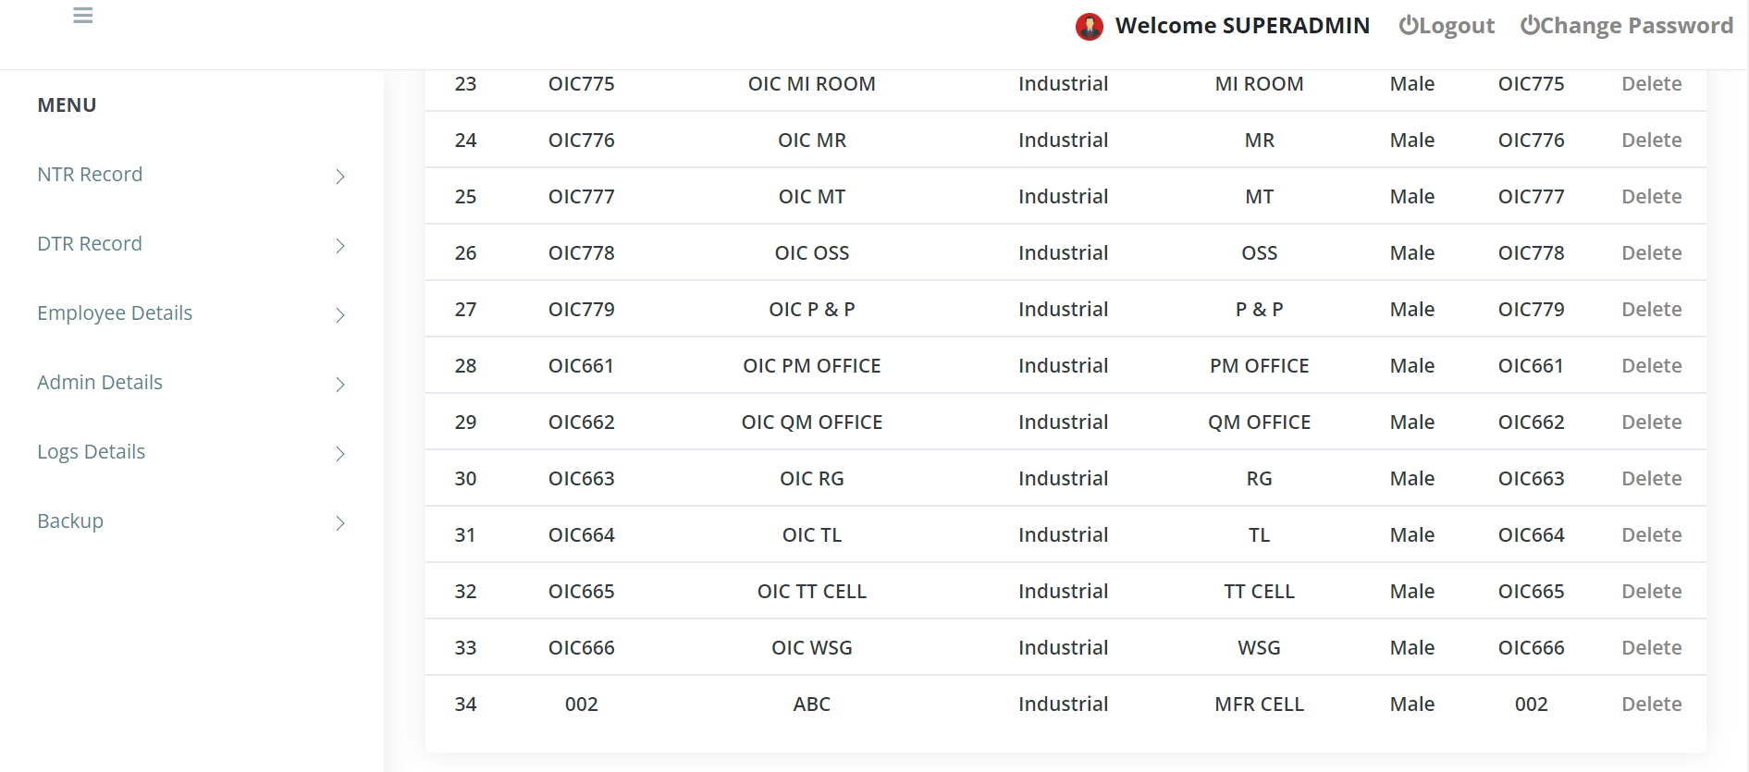
NEW ADMIN ADDED
NEW ADMIN IS ADDED SUCCESSFULLY AND IT IS DISPLAYED ON THE ADMIN DETAILS PAGE

Slide 25
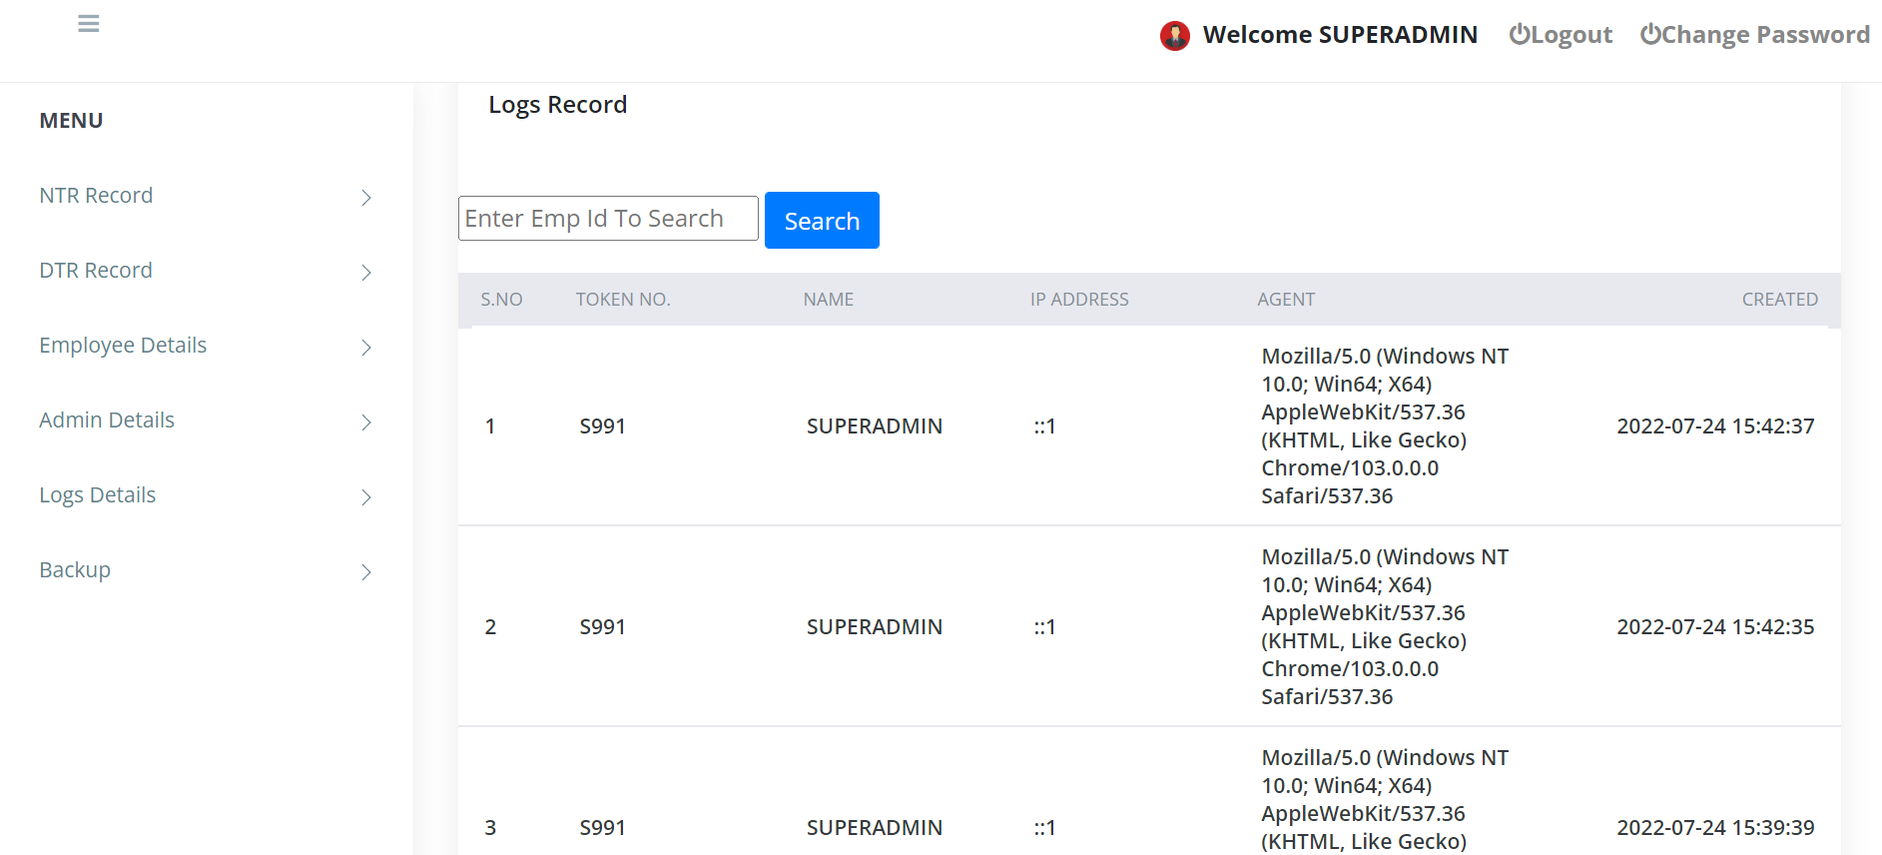
LOGS DETAILS
BY CLICKING THIS BUTTON SUPERADMIN CAN SEE ALL THE DETAILS OF THE LOGGED IN USERS

Slide 26
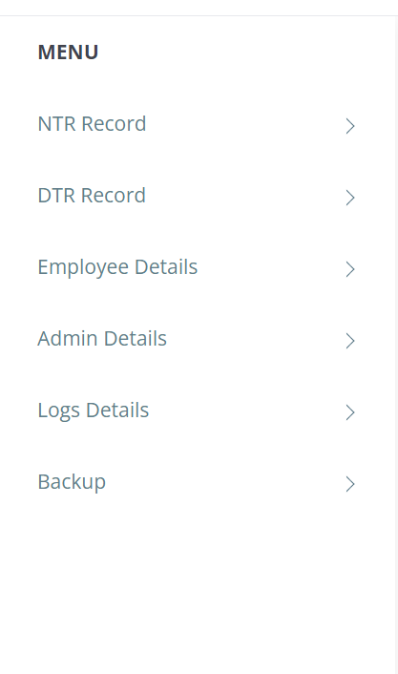
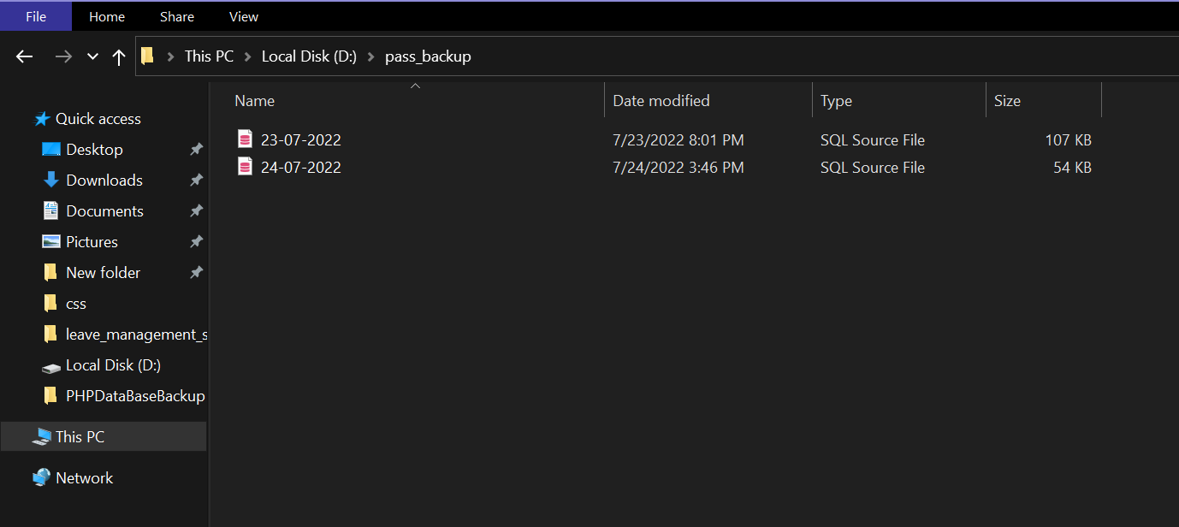
BACKUP
BY CLICKING ON THIS BUTTON BACKUP OF THE DATABASE WILL BE CREATED IN THE SYSTEM.

Slide 27
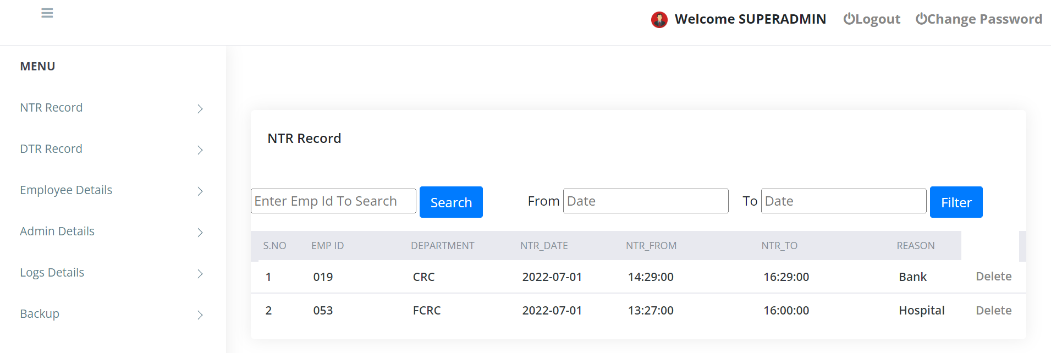
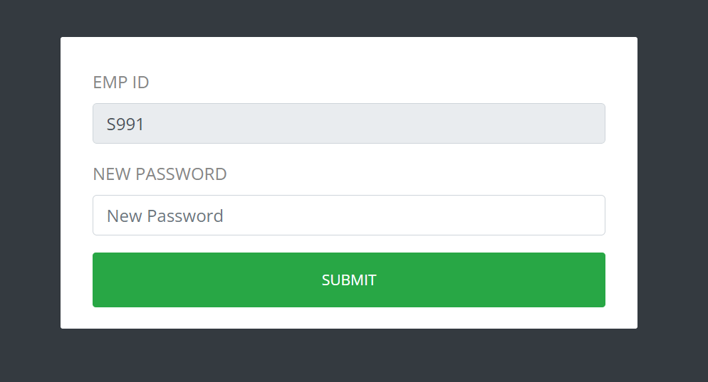
CHANGE PASSWORD
BY CLICKING ON THIS BUTTON USER CAN CHANGE ITS PASSWORD
USER NEEDS TO ENTER ITS NEW PASSWORD ONLY AND CLICK ON THE SUBMIT BUTTON, THE PASSWORD WILL BW CHNAGED.

Slide 28
LOGOUT
BY CLICKING ON THIS BUTTON USER WILL BE LOGGED OUT.

Slide 29
ADMIN can
manage records of NTR and DTR taken by employees of their respective departments.
delete NTR and DTR data of a particular employee.
manage the record of employees of their respective departments.

Slide 30
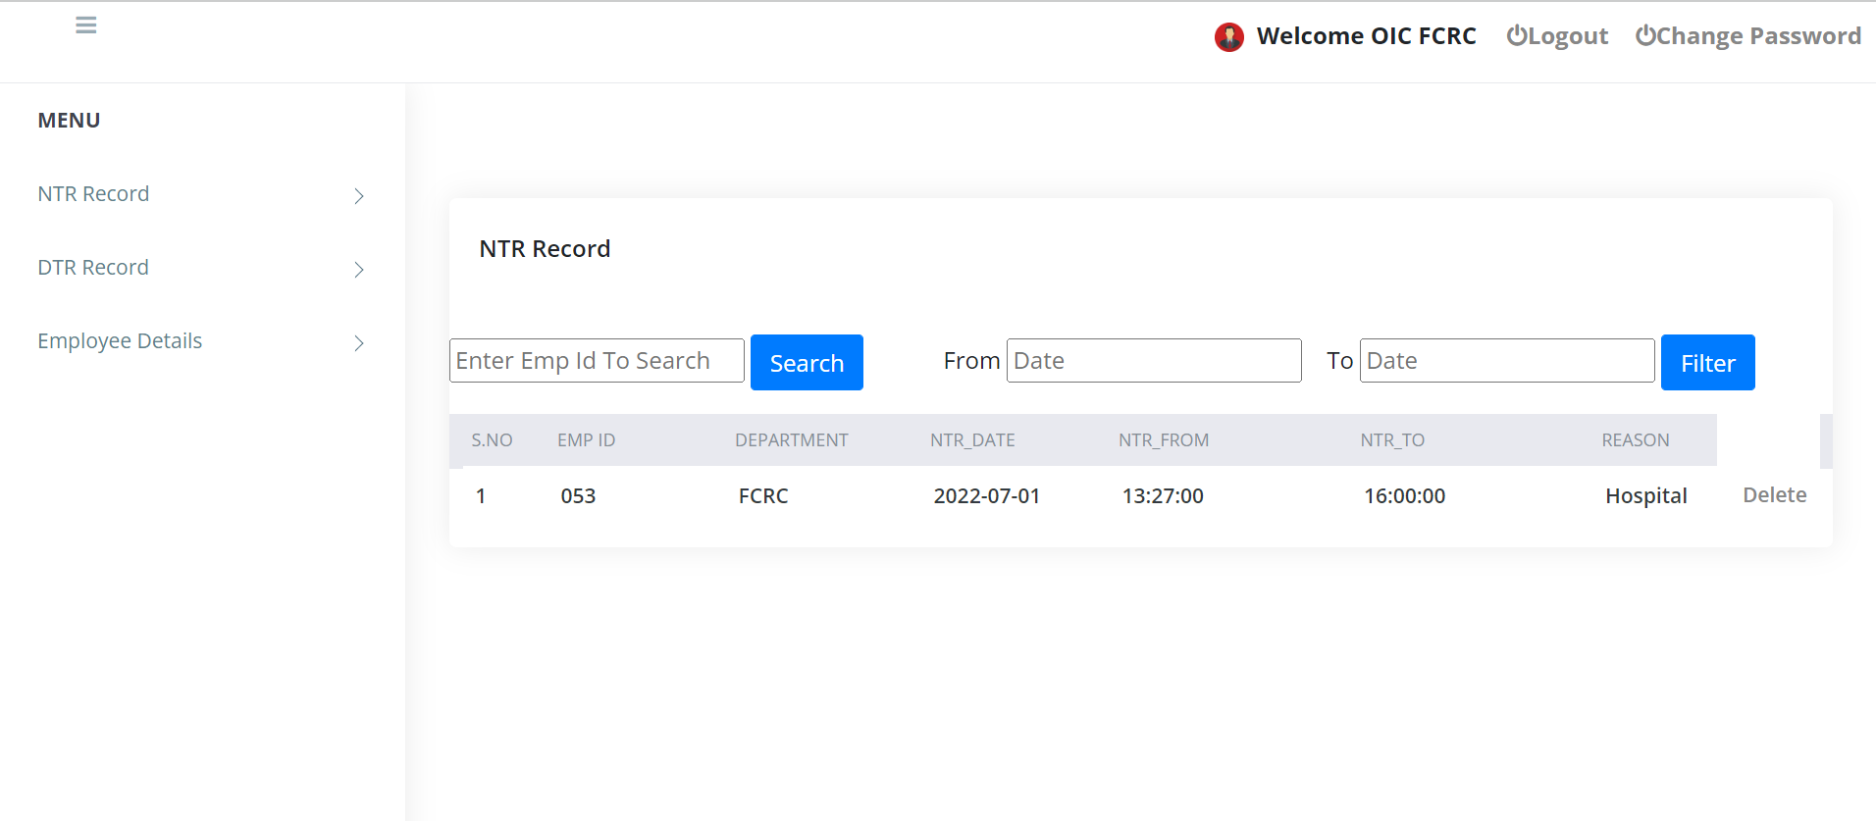
WHEN ADMIN IS LOGGED IN
THIS THE MENU THAT AN ADMIN CAN ACCESS

Slide 31
NTR RECORD
BY CLICKING THIS BUTTON ADMIN CAN SEE THE NTR RECORDS OF HIS RESPECTIVE DEPARTMENTS.

Slide 32
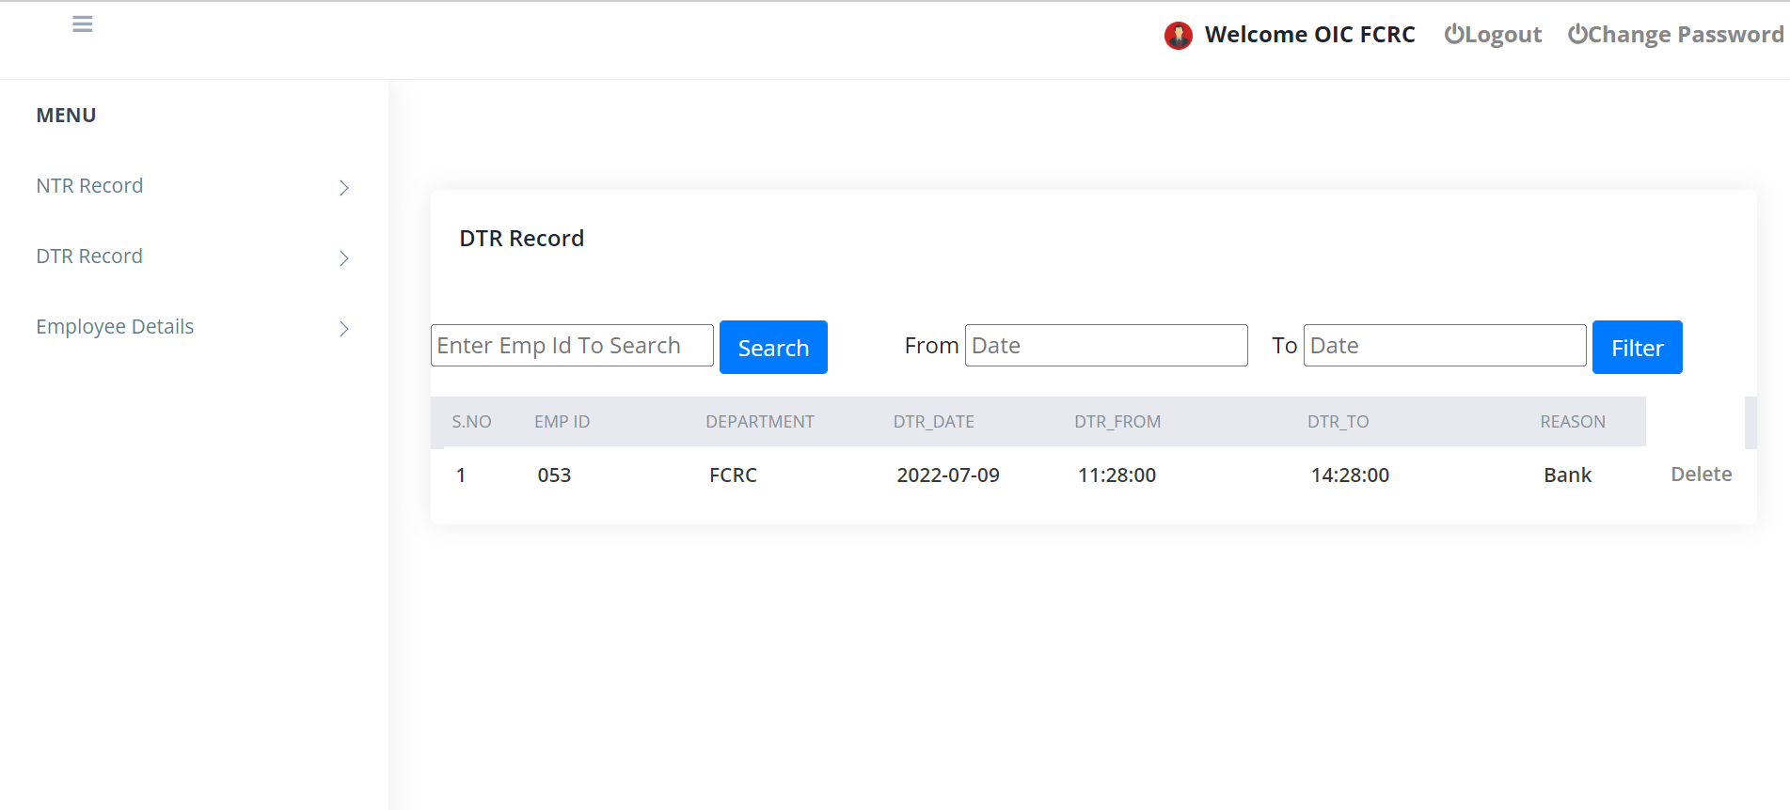
DTR RECORD
BY CLICKING THIS BUTTON ADMIN CAN SEE THE DTR RECORDS OF HIS RESPECTIVE DEPARTMENTS.

Slide 33
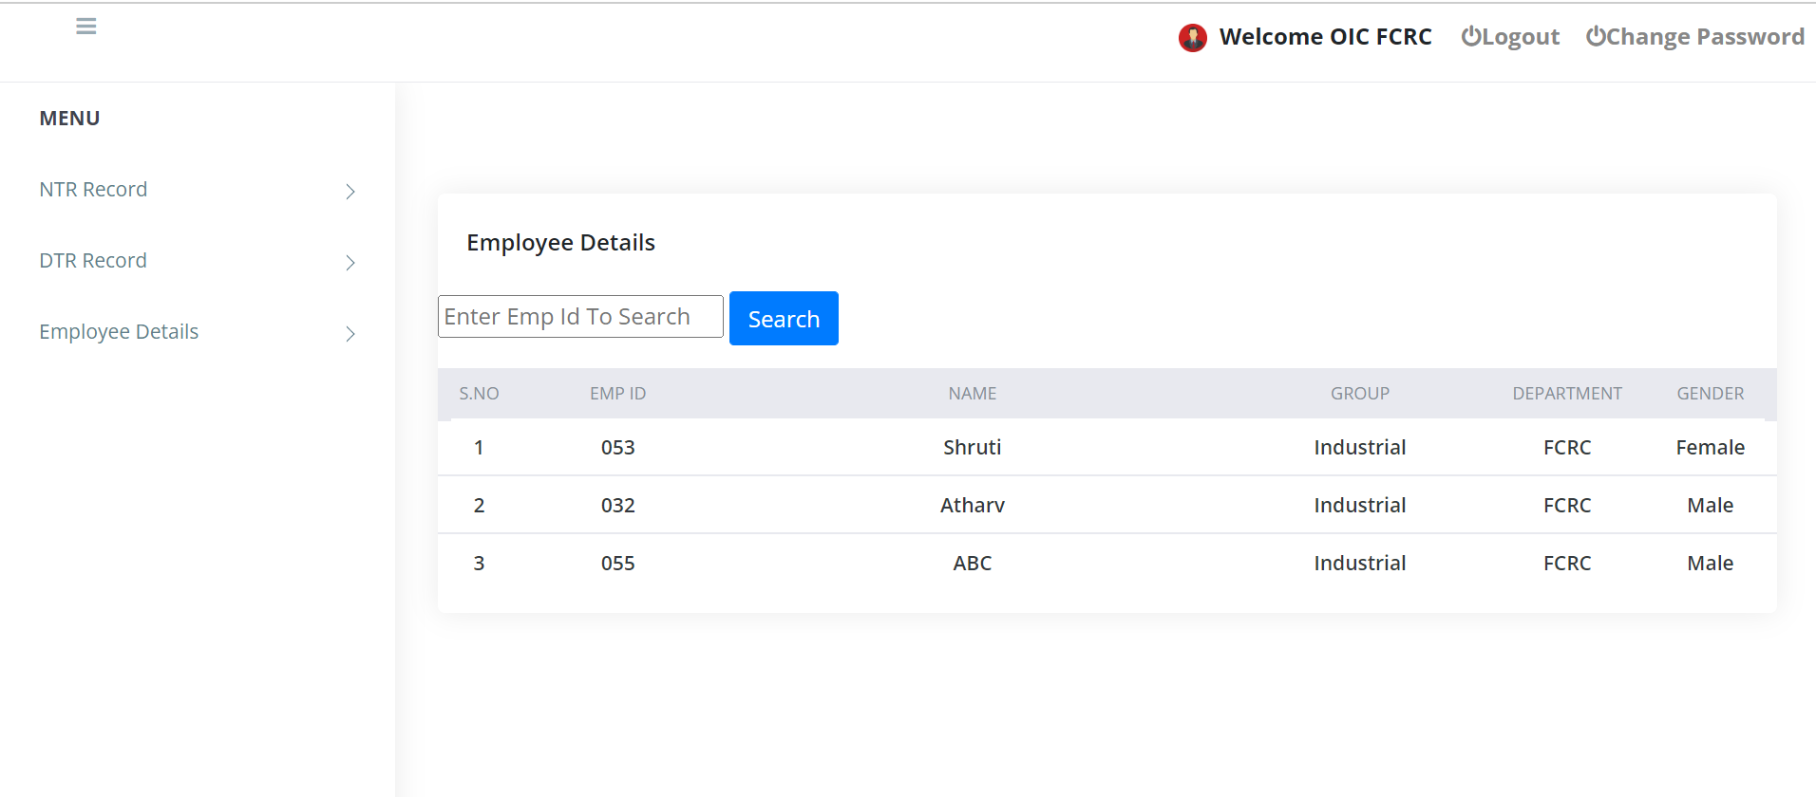
EMPLOYEE DETAILS
BY CLICKING ON THIS BUTTON ADMIN CAN SEE THE EMPLOYEES
DETAILS OF HIS RESPECTIVE DEPARTMENT

Slide 34
EMPLOYEE can
apply for NTR and DTR.
print NTR or DTR pass, when applied for a NTR or a DTR resoectively.
be able to see his record of all the NTR and DTR taken by him.
.

Slide 35
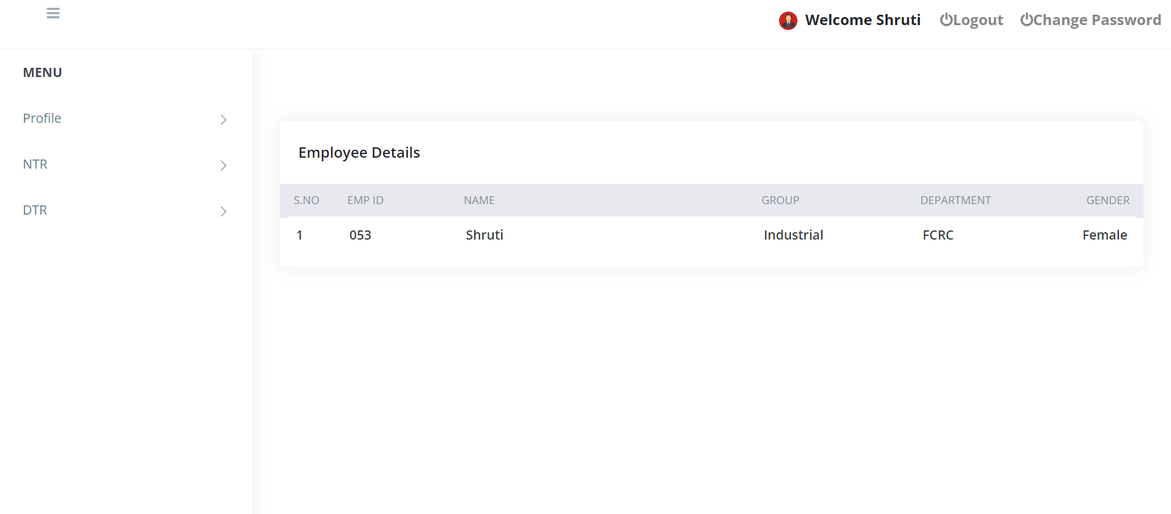
WHEN AN EMPLOYEE LOGGED IN
BY CLICKING THIS BUTTON EMPLOYEE CAN SEE ITS PROFILE.

Slide 36
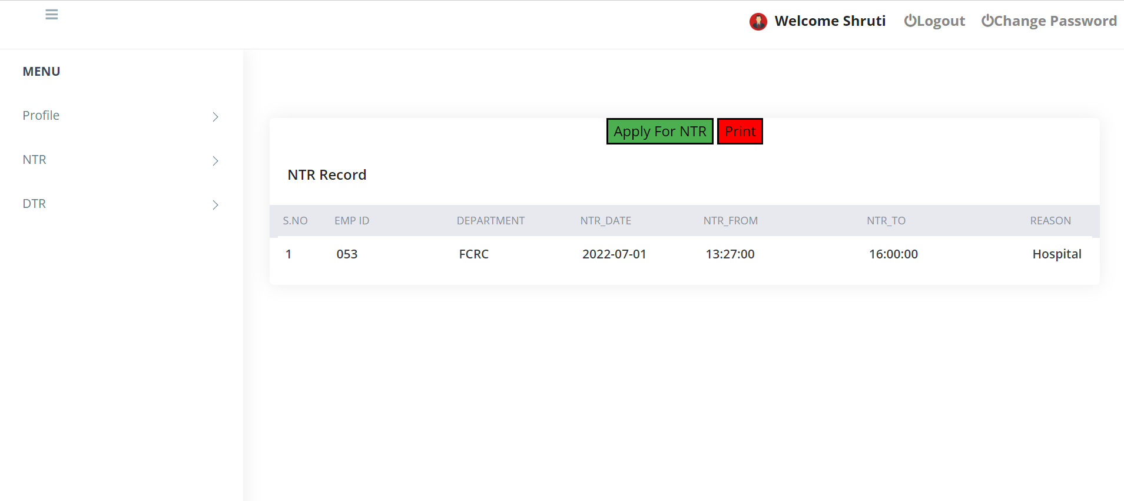
NTR DETAILS OF AN EMPLOYEE
EMPLOYEE CAN APPLY FOR NEW NTR
BY CLICKING THIS BUTTON EMPLOYEE CAN SEE HIS ALL NTR DETAILS.

Slide 37
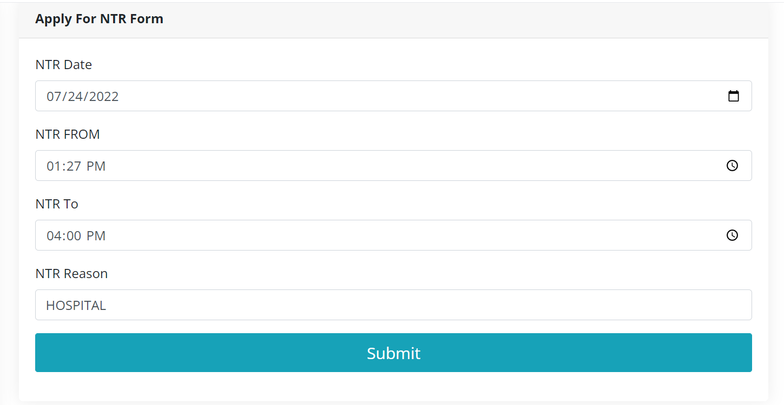
APPLY FOR NTR

Slide 38
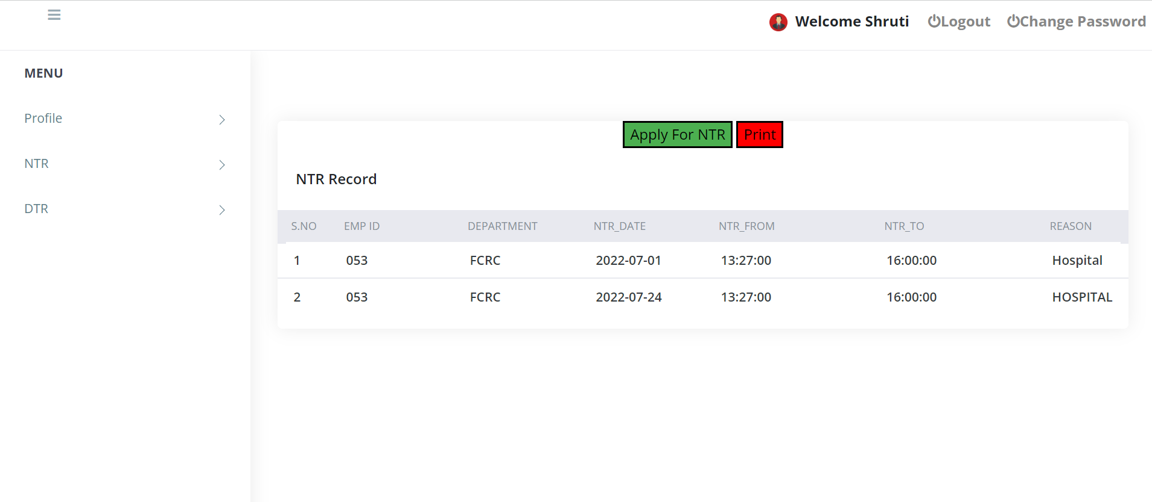
NEW APPLIED NTR
BY CLICKING ON THIS BUTTON EMPLOYEE CAN PRINT HIS NTR PASS
NEW APPLIED NTR WILL BE DISPLAYED HERE

Slide 39
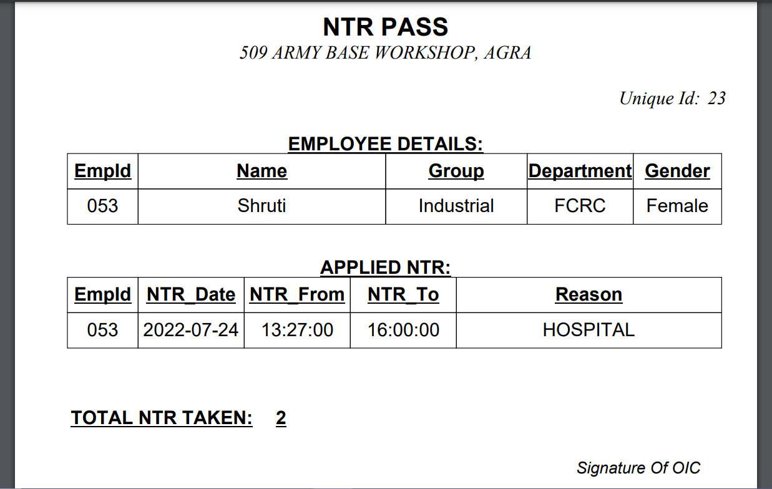
NTR PASS

Slide 40
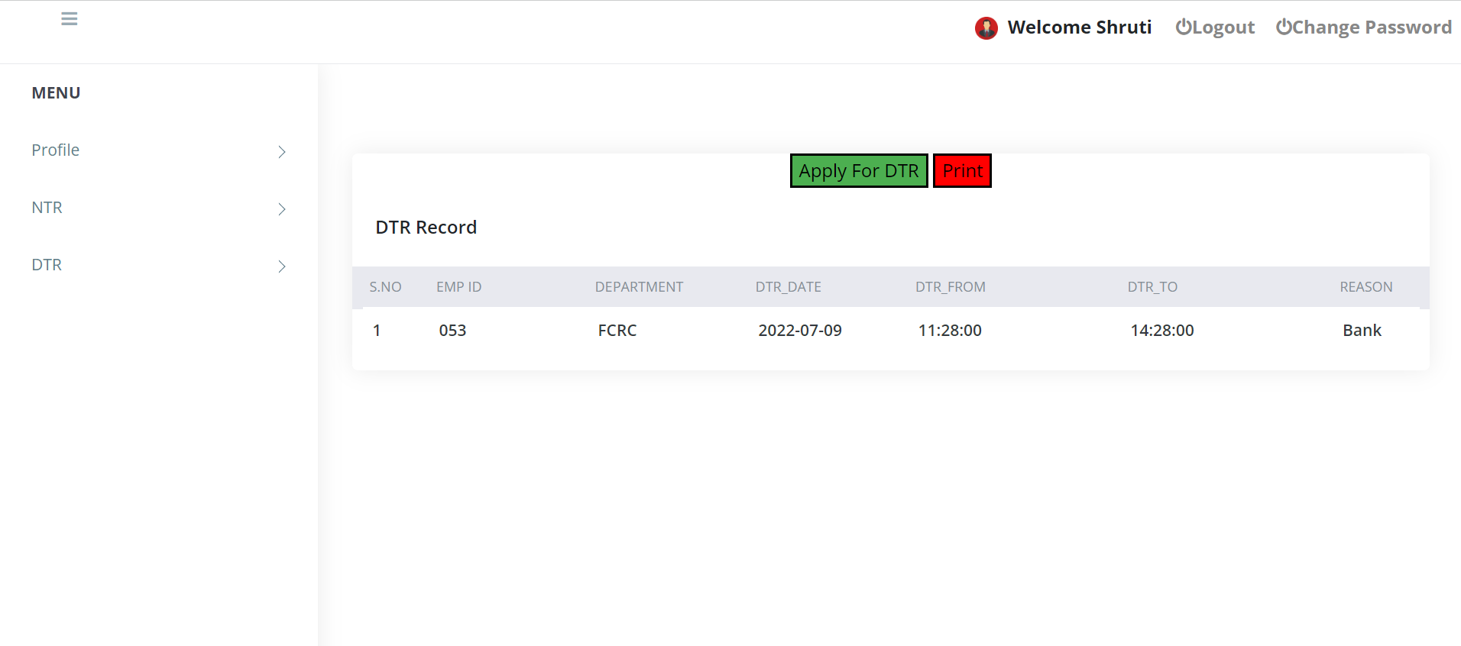
DTR DETAILS OF AN EMPLOYEE
EMPLOYEE CAN APPLY FOR NEW DTR
BY CLICKING THIS BUTTON EMPLOYEE CAN SEE THIS ALL DTR DETAILS.

Slide 41
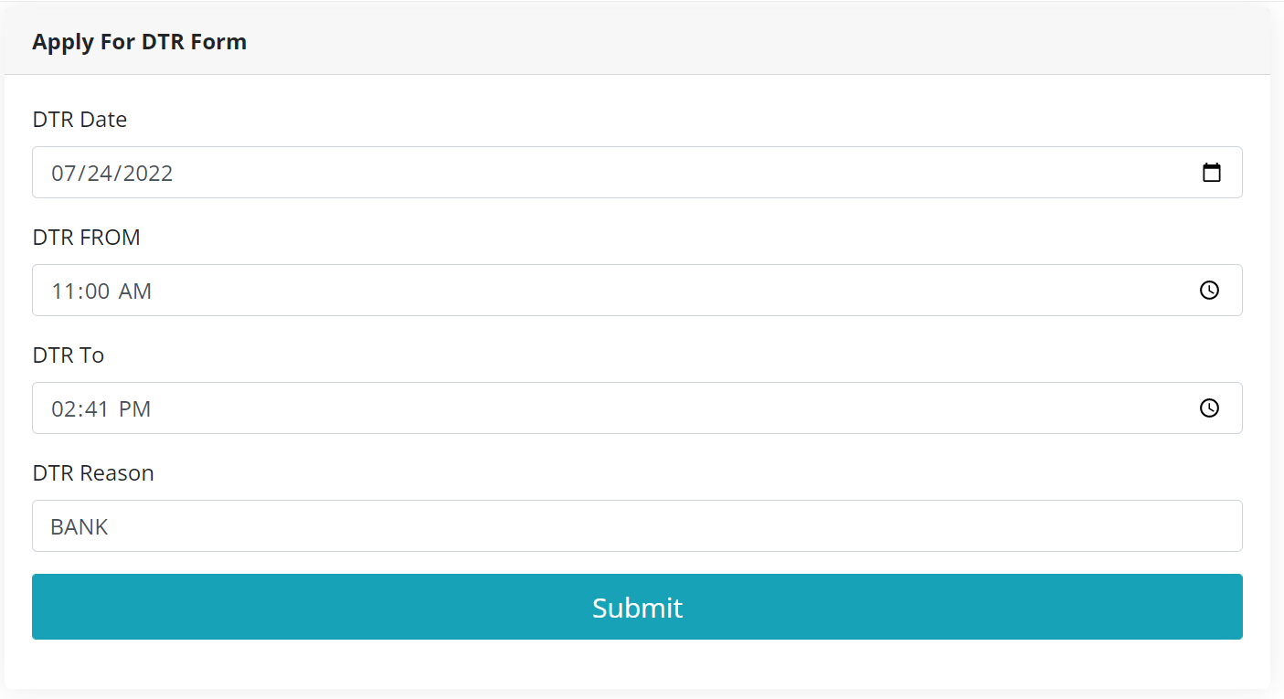
APPLY FOR DTR

Slide 42
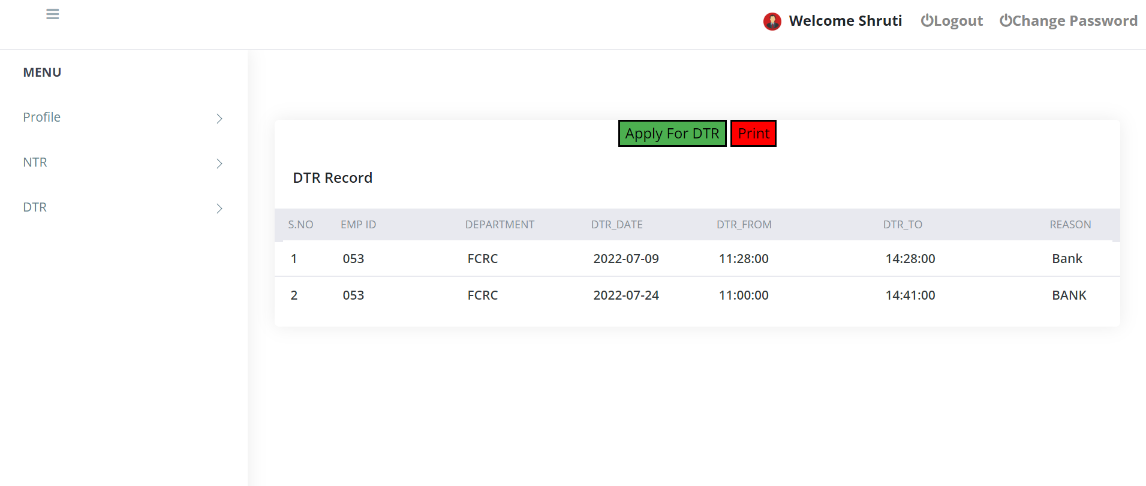
NEW APPLIED DTR
BY CLICKING THIS BUTTON EMPLOYEE CAN PRINT HIS DTR PASS
NEW APPLIED DTR WILL BE DISPLAYED HERE.

Slide 43
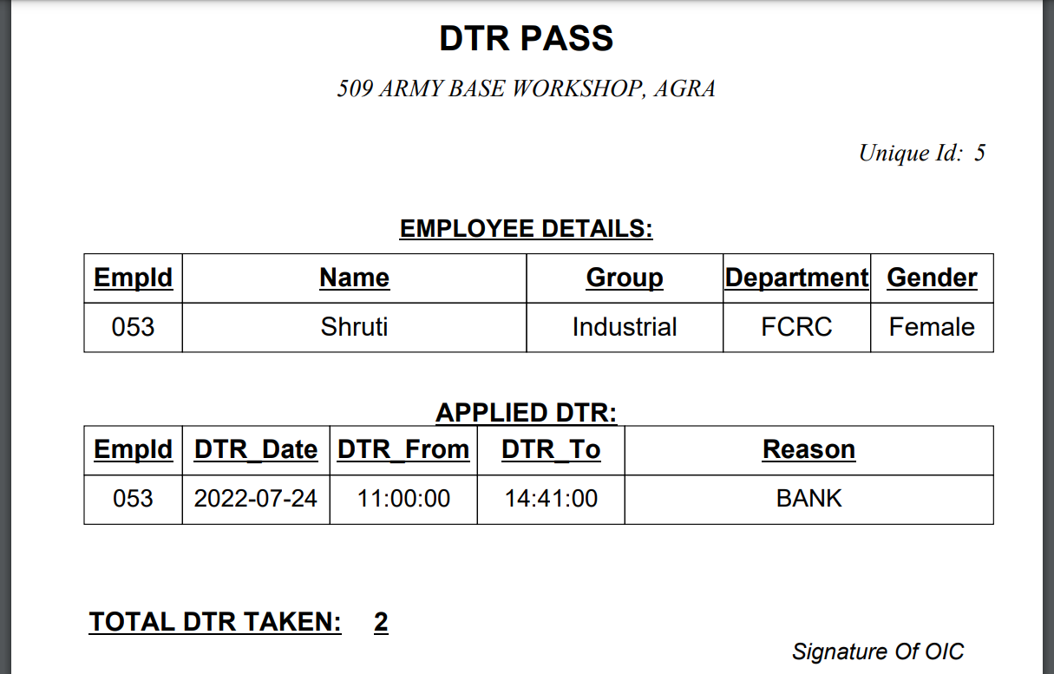
DTR PASS

Slide 44
ADVANTAGES
EASY TO USE
ACCURACY IN WORK
WORKS BECOME VERY SPEEDY
ROBUST DATABASE AT BACKEND
BETTER SECURITY
SAVES TIME
MORE EFFICIENT
ELIMINATES PAPER WORK
TRANSPARENCY

Slide 45
CONCLUSION
PASS MANAGEMENT SYSTEM is very useful for 509 Army Base Workshop as it tracks all the record of NTR and DTR taken by employees. It also maintains the details of admins and employees.
It helps the employee to apply for a NTR or DTR and it generates a pdf so that the employee can get a printout it and get it signed by his respective OIC’s.

Slide 46
.
THANK YOU

